Slide 1
Lecture 11a
The Transport Layer and Client-Server Applications

Slide 2
Internet Protocol stack
Five layer stack built around Internet Protocol (IP) from IETF
Note multiple layer 1-2, and 5 protocols
Figure source: Agrawal

Slide 3
It is Complex!
Many protocols at many layers
Link layer - Ethernet & 802.11 are major
Network layer and its “helper” protocols
IP, ICMP, ARP, DNS, DHCP, ...
Transport layer - TCP and UDP are major
Applications
HTTP, SMTP, FTP, Telnet, IM, RSS feeds, Real, Web Services, SQL, Acrobat, Flash, Other Services,...

Slide 4
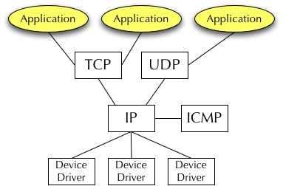
Basic Operation
Transport Layer
Schematic of TCP/IP Operation

Slide 5
The need for Transport Layer
Slide modified from Agrawal
The network layer (IP) sends packets of data to their correct destinations with best effort
Packets may get lost in transit
Therefore, network layer is not adequate for most applications to work correctly
What if the receiver cannot handle what the sender is transmitting?
Flow control between hosts
The maximum packet size in IP is 65,536 bytes, so what happens if the application wants to send a file of size 5,000,000 bytes?
Segmentation
Distinguish between applications on computers

Slide 6
Internet transport protocols services
TCP service:
Connection-oriented: setup required between client and server processes
Reliable transport between sending and receiving process
Flow control: sender won’t overwhelm receiver
Congestion control: throttle sender when network overloaded
Does not provide: timing, minimum bandwidth guarantees
UDP service:
Unreliable data transfer between sending and receiving process
Does not provide: connection setup, reliability, flow control, congestion control, timing, or bandwidth guarantee

Slide 7

But first … Applications
Figure source: Kurose & Ross
application
transport
network
data link
physical
Write programs that
run on (different) end systems
communicate over network
e.g., web server software communicates with browser software
Software not written for devices in network
Network devices do not run user applications
applications on end systems allows for rapid app development, propagation
application
transport
network
data link
physical
application
transport
network
data link
physical

Slide 8
Application architectures
How do we bridge the gap between what users need/want and what the Internet provides?
What the Internet provides (refresher)
IP provides best effort packet delivery
MAC protocols provide connectivity to end user devices
The upshot of the reference model is that we only need to worry about the Transport layer!

Slide 9
Application Architecture
Application layer
Defines those elements of application functionality that need to be standardized
Specific to particular application types
How is the app organized?
Computer/processing/data/control
Stand Alone Applications
Application resides on a single machine
Networking limited to sharing data with other copies of the same application
Example: Older Microsoft office programs
Centralized or Distributed Apps
One of each (email & WWW, resp.) →

Slide 10
Application architectures
Client-server
Peer-to-peer (P2P)
Hybrid of client-server and P2P

Slide 11
Client-server architecture
Figure source: Kurose & Ross
server:
“always-on” host
permanent IP address
server farms for scaling
clients:
communicate with server
may be intermittently connected
may have dynamic IP addresses
do not communicate directly with each other
client/server

Slide 12
Pure P2P architecture
Figure source: Kurose & Ross
No always-on server
Arbitrary end systems directly communicate
Peers are intermittently connected and change IP addresses
Example: Gnutella
Highly scalable but difficult to manage
peer-peer

Slide 13
Hybrid of client-server and P2P
Skype
Voice-over-IP P2P application
Centralized server: finding address of remote party
Client-client connection: direct (not through server)
Instant messaging
Chatting between two users is P2P
Centralized service: client presence detection/location
User registers its IP address with central server when it comes online
User contacts central server to find IP addresses of buddies

Slide 14
App-layer protocol defines
Types of messages exchanged,
e.g., request, response
Message syntax:
what fields in messages & how fields are delineated
Message semantics
meaning of information in fields
Rules for when and how processes send & respond to messages
Public-domain protocols:
defined in IETF RFCs
allows for interoperability
e.g., HTTP, SMTP
Proprietary protocols:
e.g., Skype

Slide 15
What transport service does an app need?
Data loss
Some apps (e.g., audio) can tolerate some loss
Other apps (e.g., file transfer, telnet) require 100% reliable data transfer
Bandwidth
Some apps (e.g., multimedia) require minimum amount of bandwidth to be “effective”
Other apps (“elastic apps”) make use of whatever bandwidth they get
Timing
Some apps (e.g., Internet telephony, interactive games) require low delay to be “effective”

Slide 16
Transport service requirements of common apps
Application
file transfer
e-mail
Web documents
real-time audio/video
stored audio/video
interactive games
instant messaging
Data loss
no loss
no loss
no loss
loss-tolerant
loss-tolerant
loss-tolerant
no loss
Bandwidth
elastic
elastic
elastic
audio: 5kbps-1Mbps
video:10kbps-5Mbps
same as above
> 100kbps
elastic
Time Sensitive
no
no
no
yes, 100’s msec
yes, few secs
yes, 100’s msec
yes and no

Slide 17
Implications
More in IS 1071
Networking
Connectivity requirements
What links between components are necessary?
Availability requirements
Percentage of time application or data is available to users
Performance requirements
Response time requirements
Throughput requirements
Application
What functions belong in the (end user) application?
What functions should be provided centrally?

Slide 18
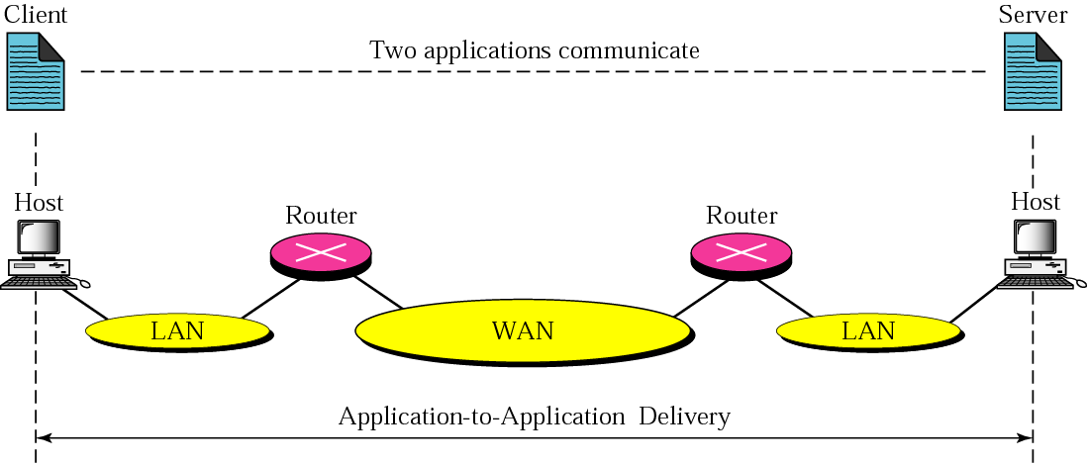
Application-to-Application Service
Hosts have many active apps →
Need app-to-app conn, not just host-to-host
1. Communication should be independent of network
Notes:
End-to-end layers don’t see the infrastructure below them

Slide 19
Transport services and protocols
application
transport
network
data link
physical
provide logical communication between app processes running on different hosts
transport protocols run in end systems
send side: breaks app messages into segments, passes to network layer
rcv side: reassembles segments into messages, passes to app layer
Internet: TCP and UDP
network
data link
physical
network
data link
physical
network
data link
physical
logical end-end transport
network
data link
physical
network
data link
physical
application
transport
network
data link
physical

Slide 20
Communications Across a Network
Communicating processes typically have a client side and a server side
Two processes on two different hosts that communicate using sockets
A socket is like a door through which messages are sent and received
Interface between the application process and the transport layer
Addressing a process
Globally unique IP address
Receive side port number

Slide 21
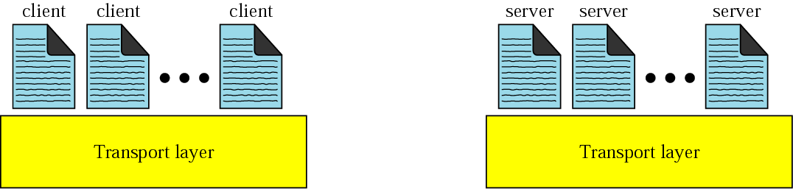
Relationship to Application Layers
“Multiplexing”
Many app-to-app connections over
the same host-to-host connection

Slide 22
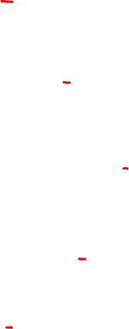
Port addresses and multiplexing
On the sender side, the operating system assigns one of the free ports to an application that requires network connectivity
How do you know what port to connect to on the receiver side?
On what port is the web server listening?
Standard ports
Assigned by IANA: Internet Assigned Numbers Authority
Notes:
Multiplexing by TCP and UDP involves the process of how a computer thinks when receiving data. The computer might be running many applications, such as a web browser, an email package, or an Internet VoIP application. TCP and UDP multiplexing tells the receiving computer to which application to give the received data.

Slide 23
Processes and Sockets
socket
Process
Transport
Layer
Transport
Layer
Process
Internet
This is the application
This is TCP, UDP, etc.
This is TCP, UDP, etc.
This is the application
Host Computer
Host Computer
Source: Computer Networking: A top down approach by Kurose and Ross
Notes:
Multiplexing relies on a concept called a socket. A socket consists of three things: (1) an IP address, (2) a transport protocol, (3) a port number
When you use three applications at the same time, three socket connections are open. Because a socket on a single computer should be unique, a connection between two sockets should identify a unique connection between two computers. This uniqueness means that you can use multiple applications at the same time, talking to applications running on the same or different computers.

Slide 24
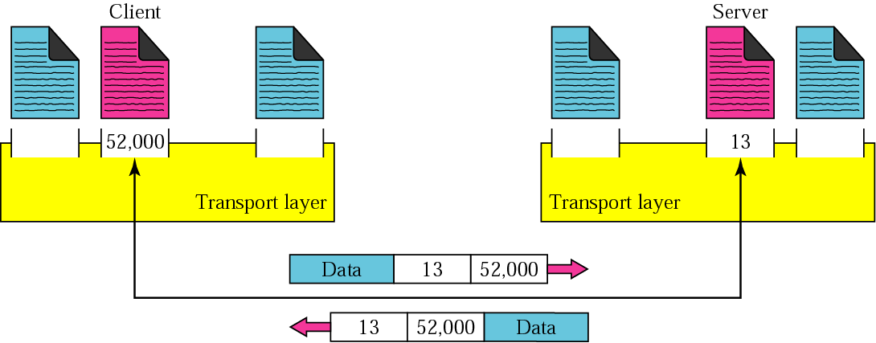
Application Addressing : Port Numbers
Clients use temporary port numbers
Servers use well-known port numbers

Slide 25
Ports and Servers
Client contacts the server initially for all communications
Server should react to the initial contact – it keeps listening to the port
It has an initial “socket object” to accept connections
It creates a new socket dedicated to a particular client after connection
The initial socket object is what we loosely call as an “open” port
It is really a half-open object
Popular standard protocols have assigned (fixed) port numbers
Clients are aware of these numbers before they place a call (contact the server)
Notes:
Port numbers are a vital part of the socket concept. Well-known port numbers are used by servers; other port numbers are used by clients. Applications that provide a service, such as FTP, Telnet, and web servers, open a socket using a well-known port and listen for connection requests. Because these connection requests from clients are required to include both the source and destination port numbers, the port numbers used by the servers must be well-know.
On client machines, where the requests originate, any locally unused port number can be allocated.

Slide 26
Standard ports
Typically ports 1 – 1023 are reserved for defined services
Applications may use the remaining port numbers 1024 – 65535
Common ports
80 : web (http)
25 : email (smtp)
443: SSL (https)
161: SNMP
To see list
In Windows:
C:/Windows/System32/drivers/etc/services
In UNIX/ Linux
/etc/services
Used ports displayed by netstat utility
Notes:
The world wide web application exists through web browsers accessing the content available on web servers. Although it is often thought of as an end-user application, you can actually use WWW to manage a router or switch. You enable a web server function in the router or switch and use a browser to access the router or switch.
SNMP (Simple Network Management Protocol) is an application layer protocol used specifically for network device management. For example, Cisco supplies a large variety of network management products, many of them in the Cisco Prime network management software product family. They can be used to query, compile, store, and display information about a network’s operation. To query the network devices, Cisco Prime software mainly uses SNMP protocols.

Slide 27
Port Numbers Continued
Port numbers by convention are low numbered
Conventions are not always followed
In UNIX and UNIX-like OSs, port numbers smaller than 1024 are privileged
Only “root” can create these ports
Remote systems were supposed to be able to trust the authenticity of these ports
Some standard port numbers
Web server (http) – 80, (https) - 443;
DNS – 53;
Mail server (smtp) – 25; SSH – 22;
Telnet server – 23; FTP – 20 and 21;
POPv2 - 109, POPv3 - 110, IMAP - 143
Notes:
The domain name system allows users to use names to refer to computers, with DNS being used to find the corresponding IP addresses. DNS also uses a client/server model, with DNS servers being controlled by networking personnel and DNS client functions being part of most any device that uses TCP/IP today. The client simply asks the DNS server to supply the IP address that corresponds to a given name.

Slide 28
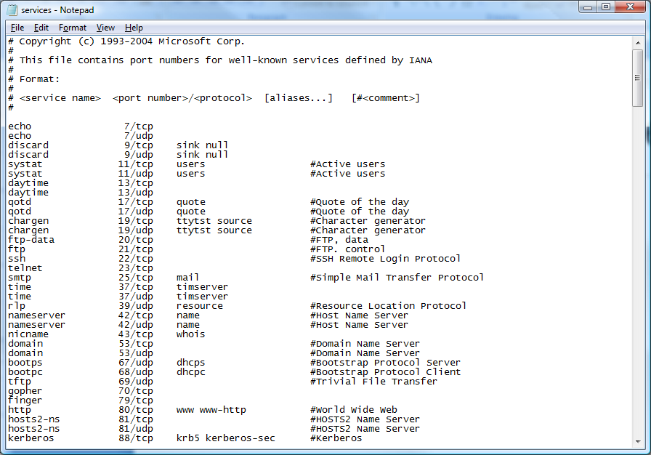
etc\services file
Show in Mac

Slide 29
Transmission Control Protocol (TCP)
Reliable transport protocol
IP is unreliable (or Best Effort)
TCP takes an unreliable network and transforms it into a reliable connection for applications
Connection-oriented protocol
Establish connection between link entities before data transfer
Contrast with connectionless
Defined in RFC 793 (Sep 1981)

Slide 30
TCP functions
TCP corrects for the imperfections of IP
Therefore TCP has to perform many tasks
Multiplexing
Segmentation
Reliability
Connection establishment
Flow-control

Slide 31
TCP Segment
There are six flag bits
ACK - indicates its ACK field is valid
RST, SYN and FIN are used for connection set up and tear down
PSH - send data to higher layers right away
URG - there is some urgent data
Source port (16 bits)
Destination port
Sequence number
Acknowledgement number
HdrLen
0
Flags
Advertised window
Checksum
Urgent pointer
Options (variable)
Data

Slide 32
TCP functions - multiplexing
Modern computers are capable of multi-tasking
Including simultaneous communication tasks
TCP supports multiplexing by providing multiple port addresses within each host
One communication channel per port
A network address and port address together is called a socket
A pair of sockets uniquely identifies each connection

Slide 33
TCP - segmentation
Sequence number of a TCP segment | = | sequence number of the previous segment + length of previous segment
TCP allows IP to transfer arbitrarily large data blocks
Accomplished by breaking data into segments (called called datagrams)
A sequence number is assigned to each datagram
Sequence numbers help receiver order datagrams even when received out of order

Slide 34
Sequence Numbers in TCP
Sequence and acknowledgment numbers are very important in TCP for reliable data transfer
The sequence number of a TCP segment tells the receiver how many bytes of data has been sent
Example: the first TCP segment carries 320 bytes of data and the sequence number is 301, the next TCP segment will have a sequence number 621
The acknowledgment number tells the recipient what is the next expected byte number
Example: the server receives 1000 bytes from the TCP segment with sequence number 235 - it has received bytes numbered 235 through 1234. So its sets the ACK number to be 1235

Slide 35
TCP functions - reliability
Datagrams may get seriously damaged during transmission
If datagrams are further fragmented by IP, some IP fragments may get lost during transmission
These errors cannot be detected by Ethernet
Such damage is corrected by adding a checksum to each datagram and comparing it at the receiver
Damaged datagrams are discarded and retransmitted by sender since no ACK is received
Notes:
TCP provides for reliable data transfer, which is also called reliability or error recovery. To accomplish reliability, TCP numbers data bytes using the Sequence and Acknowledgement fields in the TCP header. TCP achieves reliability in both directions, using the Sequence Number field of one direction combined with the Acknowledgment field in the opposite direction.

Slide 36
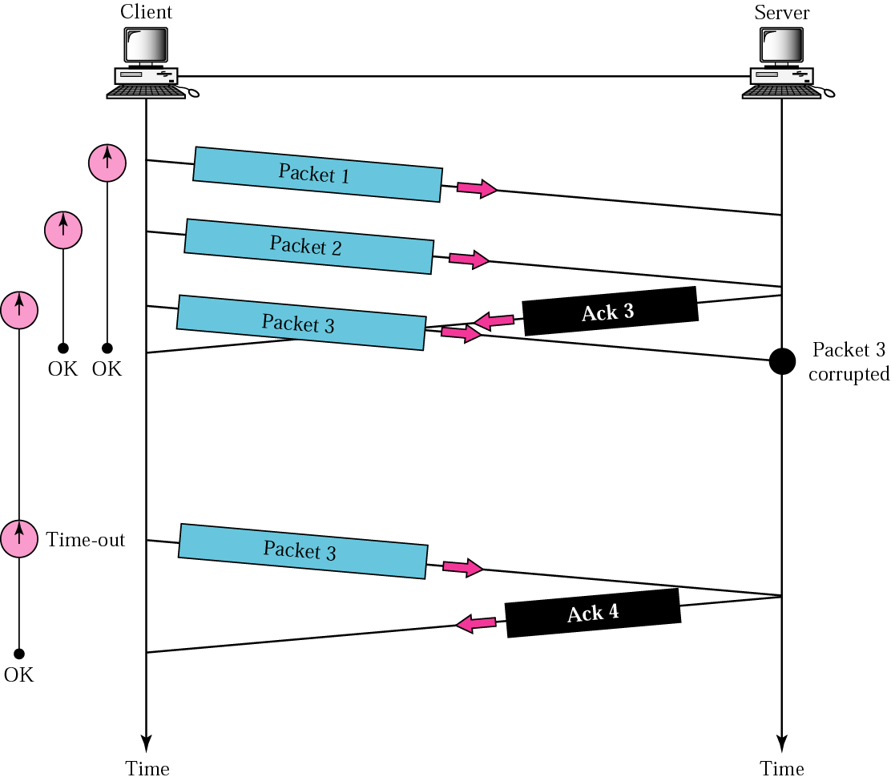
Error Control (Retransmission)

Slide 37
TCP functions - segmentation
Advantages
Errors are less likely in smaller segments
Less retransmission if error is introduced in a segment
Easier for routers to hold segments in memory if onward route is busy
Disadvantages
More computations in sending and receiving
Duplicates are possible and must be detected

Slide 38
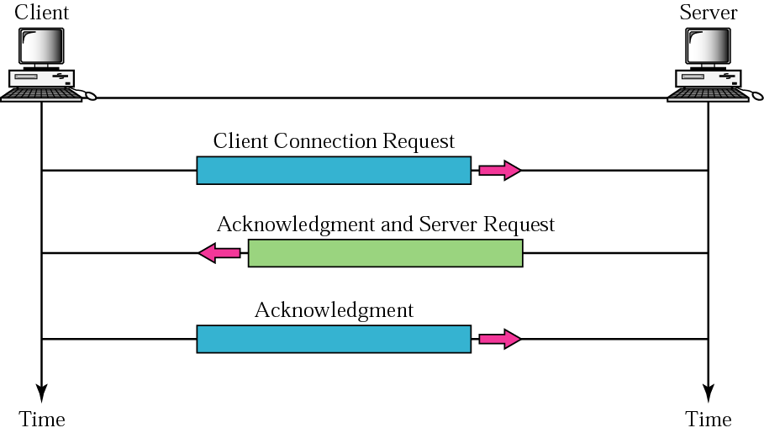
TCP Connection Establishment
TCP uses error detection and correction
TCP uses sliding window flow control
These occur between the two hosts, not with the network
Notes:
This three-way connection establishment flow (also called a three-way handshake) must complete before data transfer can begin. The connection exists between the two sockets, although the TCP header has no single socket field. Of the three parts of a socket, the IP addresses are implied based on the source and destination IP addresses in the IP header. TCP is implied because a TCP header is in use, as specified by the protocol field value in the IP header. Therefore, the only parts of the socket that need to be encoded in the TCP header are the port numbers.

Slide 39
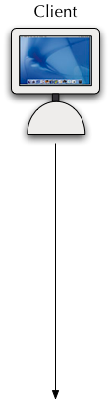




TCP Connection Management
Client wants to initiate connection to server
It sends a special TCP segment to the server with the SYN bit set to 1
The initial sequence number is say client_isn
This is called a SYN segment
Server receives the SYN segment
It allocates buffers and variables to the connection and replies
Reply has SYN = 1, acknowledgment number = client_isn +1
Sequence number is server_isn
This is called a SYNACK segment
Connection is completed
Three-way Handshake
Notes:
TCP signals connection establishment using 2 bits inside the flag fields of the TCP header. Called the SYN and ACK flags, these bits have a particularly interesting meaning. SYN means synchronize the sequence numbers, which is one necessary component in initialization for TCP.

Slide 40
Details of Connection
Management

Slide 41
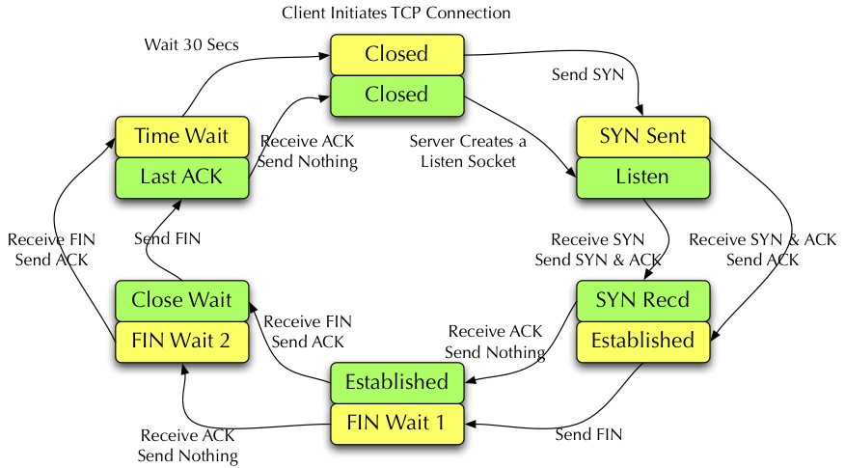
TCP States - Client and Server

Slide 42
Connection Termination
The graceful method to terminate the connection is to use the FIN field followed by ACK
In this case, either the client or the server will first send a TCP segment with the FIN bit set
The receiving host will ACK the FIN
This process closes half the connection - it has to be repeated by the receiving host
The abrupt method of closing the TCP connection is for either the client or the server to send an RST (reset) segment
This aborts the TCP connection and no further communications take place between the hosts

Slide 43
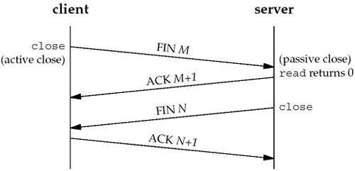
Connection Termination

Slide 44
TCP functions – flow control
If the receiver is slow, it will not be able to process the packets reaching it fast enough
Therefore, TCP enables the receiver to limit the sender’s data rate
If sender is slow, it only tests the patience of receivers
There is no packet loss
Also, sender is already transmitting at max possible rate
Notes:
TCP implements flow control y using a window concept that is applied to the amount of data that can be outstanding and awaiting acknowledgment at any one point in time. The window concept lets the receiving host tell the sender how much data it can receive right now, giving the receiving host a way to make the sending host slow down or speed up. The receiver can slide the window size up and down to change how much data the sending host can send.

Slide 45
Stop and Wait Flow Control

Slide 46
TCP functions – flow control
TCP flow control is accomplished by returning a “window” with every ACK
“Window” indicates how many bytes of data the sender may transmit before receiving any more ACK
The window size increases with every correct packet
This continues until a NAK is received, when the window size becomes “1”
Thus, the throughput follows a sawtooth pattern
Throughput
time

Slide 47
Stop and Wait with window size

Slide 48
Sliding window
Flow control is the regulation by the receiver of the amount of data the sender may send
Creates a “sliding window” at the sender
Packets that have received permission for transmission are within the window
Window slides through the data as receiver acknowledges packets or modifies window size

Slide 49
Sliding window

Slide 50
Sliding Windows
Normally a data link layer concept.
Our interest is understanding the TCP mechanism at the transport layer.
Each frame is assigned a sequence number: SeqNum.
The sender maintains three variables: send window size (SWS), last ACK received (LAR), and last Frame sent (LFS).

Slide 51
Sender Variables
SWS :: the upper bound on the number of outstanding frames (not ACKed) the sender can transmit.
LAR :: the sequence number of the last ACK received.
LFS :: the sequence number of the last frame sent.

Slide 52
Sender Invariant
LFS – LAR <= SWS
<=SWS
LAR
LFS

Slide 53
Sender Window
An arriving ACK ➔ LAR moves right 1
➔ sender can send one more frame.
Associate a timer with each frame the sender transmits.
Sender retransmits the frame if the timer times out.
Sender buffer :: up to SWS frames.

Slide 54
Receiver variables
Receiver window size (RWS) :: the upper bound on the number of out-of-order frames the receiver is willing to accept.
Largest acceptable frame (LAF) :: the sequence number of the largest acceptable frame.
Last frame received (LFR) :: the sequence number of the last frame received.

Slide 55
Receiver Invariant
LAF – LFR <= RWS
<=RWS
LFR
LAF

Slide 56
Receiver Window
When a frame arrives with SeqNum:
If (SeqNum <= LFR or SeqNum > LAF)
the frame is discarded because it is outside the window.
If (LFR < SeqNum <= LAF)
the frame is accepted.

Slide 57
Receiver ACK Decisions
SeqNumToAck :: largest sequence number not yet ACKed such that all frames <= SeqNumToAck have been received.
Receiver ACKs receipt of SeqNumToAck
and sets
LFR = SeqNumToAck
LAF = LFR + RWS
SeqNumToAck is adjusted appropriately!

Slide 58
TCP Sliding Windows
In practice, the TCP implementation switches from packet pointers to byte pointers.
Guarantees reliable delivery of data.
Ensures data delivered in order.
Enforces flow control between sender and receiver.
The idea is: the sender does not overrun the receiver’s buffer.

Slide 59
Receiver’s Advertised Window
The big difference in TCP is that the size of the sliding window size at the TCP receiver is not fixed.
The receiver advertises an adjustable window size (AdvertisedWindow field in TCP header).
Sender is limited to having no more than AdvertisedWindow bytes of unACKed data at any time.

Slide 60
TCP Flow Control
The discussion is similar to the previous sliding window mechanism except we add the complexity of sending and receiving application processes that are filling and emptying their local buffers.
Also we introduce the complexity that buffers are of finite size without worrying about where the buffers are stored.
MaxSendBuffer
MaxRcvBuffer

Slide 61
TCP Flow Control
Receiver throttles sender by advertising a window size no larger than the amount it can buffer.
On TCP receiver side:
LastByteRcvd - LastByteRead<=MaxRcvBuffer
to avoid buffer overflow!

Slide 62
TCP Flow Control
TCP receiver advertises:
AdvertisedWindow = MaxRcvBuffer -
(LastByteRcvd - LastByteRead)
i.e., the amount of free space available in the receiver’s buffer.

Slide 63
TCP Flow Control
The TCP sender must adhere to AdvertisedWindow from the receiver such that
LastByteSent – LastByteAcked <= AdvertisedWindow
or use EffectiveWindow:
EffectiveWindow = AdvertisedWindow – (LastByteSent – LastByteAcked)

Slide 64
TCP Flow Control
Sender Flow Control Rules:
EffectiveWindow > 0 for sender to send more data.
LastByteWritten – LastByteAcked <= MaxSendBuffer
equality here ➔ send buffer is full!!
➔ TCP sender process must block the sender application.
Animation link

Slide 65
UDP: User Datagram Protocol [RFC 768]
“no frills,” “bare bones” Internet transport protocol
“best effort” service, UDP segments may be:
lost
delivered out of order to app
connectionless:
no handshaking between UDP sender, receiver
each UDP segment handled independently of others
Why is there a UDP?
No connection establishment: (which can add delay)
Simple:
no connection state at sender, receiver
Small header
No congestion control:
UDP can blast away as fast as desired
Notes:
UDP provides a service for applications to exchange messages. Unlike TCP, UDP is connectionless and provides no reliability, no windowing, no reordering of the received data, and no segmentation of large chunks of data into the right size for transmission. However, UDP provides some functions of TCP, such as data transfer and multiplexing using port numbers, and it does so with fewer bytes of overhead and less processing required than TCP. UDP data transfer differs from TCP data transfer in that no reordering or recovery is accomplished. Applications that use UDP are tolerant of the lost data, or they have some application mechanism to recover lost data. For example, VoIP uses UDP because if a voice packet is lost, by the time the loss could be noticed and the packet retransmitted, too much delay would have occurred, and the voice would be unintelligible. Also DNS requests use UDP because the user will retry an operation if the DNS resolution fails. As another example, the Network File System (NFS), a remote file system application, performs recovery with application layer code, so UDP features are acceptable to NFS.

Slide 66
UDP
32 bits
Used for streaming multimedia apps, VoIP
loss tolerant
rate sensitive
other UDP uses
DNS
SNMP
reliable transfer over UDP: add reliability at application layer
application-specific error recovery!
Length, in
bytes of UDP
segment,
including
header
source port #
dest port #
length
checksum
Application
data
(message)
UDP segment format

Slide 67
Discussion
TCP
Provides a reliable, connection-oriented data transfer
Uses much more protocol overhead (at least 20 bytes)
UDP
Provides unreliable, connectionless data transfer
Uses much less protocol overhead (8 bytes)
Both use encapsulation
Application messages and overhead are considered “Data” to TCP and UDP
They do not recognize them and do not process them

Slide 68
Example of Encapsulation
Original HTTP Request
Request Line
Headers
Request Body
TCP Segment
Notice there are TWO segments
TCP Header
Request Line
Headers
TCP Header
Request Body
IP Packets sent
IP Header
TCP Header
Request Line
Headers
IP Header
TCP Header
Request Body
Ethernet Frame
Eth. Header
IP Header
TCP Header
Request Line
Headers
CRC
Eth. Header
IP Header
TCP Header
Request Body
CRC

Slide 69
TCP/ IP technologies by layer

Slide 70
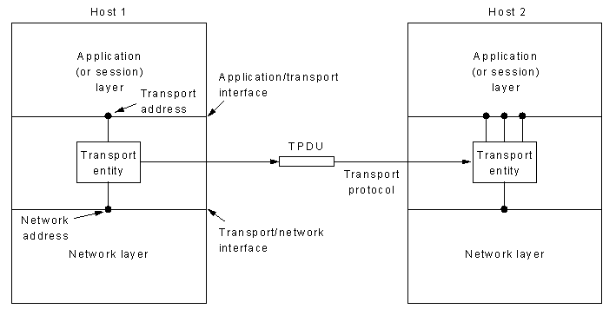
Summary: Transport Layer
Provides services for the transfer of data between end points independent of the physical network infrastructure.
Can provide end-to-end error recovery and flow control, security

Slide 71
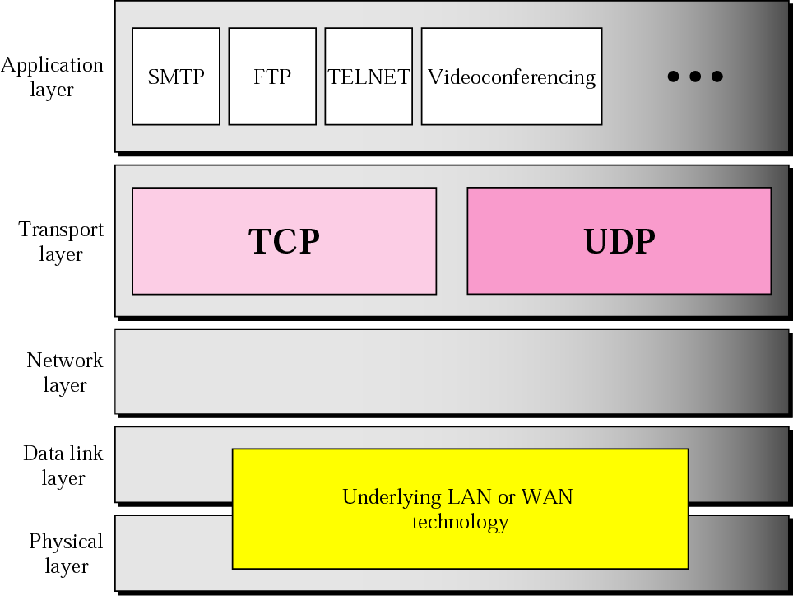
Summary
Transport Layer
Why necessary
TCP
Format
Segments
Sliding Window Flow/Error control → reliable
UDP
Format
Unreliable
Real-time applications
Ports

